Slide 1


Ansible on Windows
Notes:
Instructor: Ask for participants previous knowledge of windows ecosystem, what a domain is, what PowerShell is
Welcome to a short presentation about Ansible on Windows.
Ansible is among the leading tools when it comes to configuration management in the Linux world.
Its strong points are:
YAML based playbook – More readable to human eyes and thus simpler to understand
Everything is written in Python – More oriented administration language that is very common
No agent required to be installed on the managed host
Windows is one of the most common operating systems both for businesses and homes.
As the desire to manage “Infrastructure as Code” gains ground in the Windows world as well, Ansible tries to fill the gap.
Although Microsoft has SSCM as their platform for infrastructure deployment, its still falls short on being a true cross platform tool.
Ansible treats Windows host in the same manner it treats Linux hosts, the main differences are in the
communication layer between the controller and the hosts and by the modules used to perform the actions.

Slide 2
Ansible on Windows
Requirements
PowerShell version 3.0
Windows 7 and Windows Server 2008/R2
Windows XP and Windows Server 2012/R2 come with PS 4.0
Preferably update to latest Windows Management Framework 5.1 (includes PowerShell 5.1).
Verify version by $PSVersionTable
.Net Framwork 4.0
Ansible Controller still requires Linux OS
Notes:
Instructor: Emphasis the requirement for a Linux OS for the controller, so even organizations that are fully MS shop, require one Linux Server.
That said, with the growing technology of containers, it is possible to create a Docker for Windows container that hosts an Ansible Controller.
https://blogs.technet.microsoft.com/albertwo/2017/05/09/building-an-ansible-controller-in-docker-for-windows-to-managing-azure-deployments/
These are the basic requirements to run Ansible.
This presentation will discuss Ansible 2.0+

Slide 3
Ansible on Windows
Windows PowerShell
Windows PowerShell is “THE” scripting language for Windows.
It has been developed, maintained and grown for over 10 years.
Every server MS product and OS will have built-in support for PowerShell.
It is based as a layer on top of c#, without the complexity of the language.
Latest version is Windows PowerShell 5.1 and is considered feature-complete.
Notes:
Windows PowerShell is “THE” scripting language for Windows.
(at least if you ask Microsoft about it)
Microsoft is highly committed to PowerShell so that every product it releases (Server products) will have built-in support for PowerShell, meaning there
will be a new set of PowerShell commands available after installing the product to manage it.
In the last 2 years, Microsoft has ported ‘Windows PowerShell’ to ‘PowerShell’ (note the missing ‘Windows’ at the start).
Also referred to as PowerShell Core, as its based on .NET Core
PowerShell is an open-source project on GitHub that is cross-platform (runs on Linux distributions and MacOS) and allows most of the ‘Windows PowerShell’ scripts to also run on non-MS operating systems with minimum if any changes.
Microsoft is considering ‘Windows PowerShell’ to be feature-complete which means no further development is done on it except security issues.
Most of the work is now being diverted into creating ‘PowerShell’ – a scripting language for most operating systems in the market.
Because It relies on .NET Core that is the open-source, cross platform framework, it means PowerShell (referred to sometimes as PowerShell Core) will be available to all Linux distributions and MacOS.

Slide 4
Ansible on Windows
Windows PowerShell
Based on Verb-Noun commands (called cmdlets).
Get-Service, Get-Process, Copy-Item, Where-Object
Introduces pipeline command concept.
Get-Service spooler | Restart-Service
Get-Service | Where-Object {$_.Status –ne ‘Running’}
Notes:
Instructor: Run the 2 powershell exmaples to see results
List of common basic PowerShell commands
https://blogs.technet.microsoft.com/heyscriptingguy/2015/06/11/table-of-basic-powershell-commands/
Pipeline – In PowerShell, everything is an object. A pipeline is the results of executing a command and then passing its results to the next command.
In the example, the command ‘Get-Service’ accepts a parameter, in this case the name of the service.
Once that command is executed the result is an object that represents the process with all of its associated properties and methods, which is then moved to the next step in the pipeline and that’s the ‘Restart-Service’.
The end results is that a service called spool is restarted.
The second example is bit more sophisticated, its gets a list of all the exsiting services and then filters it to show only the services that their status is not
‘running’

Slide 5
Ansible on Windows
Windows Domain
Ansible Controller is a Domain member
The user you log in as, will be used to run Ansible on the host
A Windows Domain is mapped to one Ansible Inventory
Multiple Domains, require one Ansible Inventory per Domain.
Notes:
Active Directory Services is Microsoft implementation of User and Computer identity security management.
It’s a central location holding all the users and computers login information (including passwords) and authenticates them upon login.
There will be at least one Domain in each ADS setup. All users will be part of the domain, when accessing resources located in the domain, it will force authentication to gain access to the resources.

Slide 6
Ansible on Windows
Communication
With Linux hosts, Ansible communicates via SSH.
With Windows hosts, Ansible communicates via python library for WinRM.
In next version of Windows, OpenSSH will be supported out of the box.
PowerShell Remoting will allow communication with OpenSSH as well as WinRM.
Notes:
Ansible connects to Linux via SSH.
Since there's no built-in support for SSH in Windows yet, Ansible uses a python library pywinrm to communicate with WinRM
More information about how to setup Ansible with pywinrm to talk to Windows can be found here:
https://digitalist.global/talks/winrmansible/
Microsoft is adopting OpenSSH and will support it in the next OS version.
It is working into incorporating OpenSSH as another method of communication so that Linux based system can talk to Windows natively.

Slide 7
Ansible on Windows
Windows Remoting Management (WinRM)
Communication Protocol that exists in all Windows OS
Not enabled by default.
To enable, run (in Admin mode):
Enable-PSRemoting
This creates a http/https listener on port 5985/5986
Verify WinRM is listening by running:
winrm enumerate winrm/config/listener
Notes:
WinRM is installed by default on all Windows OS but isn’t enabled.
Enabling requires running a PowerShell command in admin mode
This in turn creates a http/s listener.

Slide 8
Ansible on Windows
Common Administration Actions
Enable, Disable Windows Features
Stop, Start, Manage Services
Create, Manage local groups and users
Copy Files
Manage Registry

Slide 9
Ansible on Windows
Common Ansible Modules
win_feature – Controls installation of windows feature (like IIS etc)
win_group – Creates local groups
win_user – Creates local users
win_service – Manages services
win_copy – Copy files
win_regedit – Manage registry settings
win_get_url – Fetch files over http
win_share – Creates and Manages Shares

Slide 10
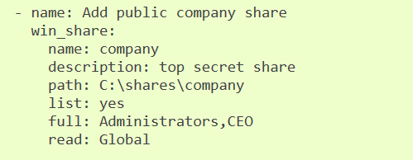
Ansible on Windows
win_share
Notes:
This is taken from the Ansible modules site.
It creates a share called ‘company’ that is mapped to a local drive path of ‘C:\Shares\company’
and sets its permissions to specific groups

Slide 11
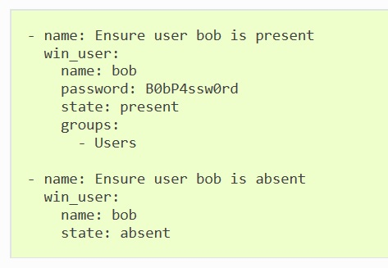
Ansible on Windows
win_user
Notes:
This is taken from the Ansible modules site
The first example creates a use call bob with specific password and maps it to the local Users group
The second example is making sure a user by the name of bob will be removed if it exists.

Slide 12
Ansible on Windows
Additional Information
Windows User Guide for Ansible
http://docs.ansible.com/ansible/latest/user_guide/windows.html
Windows Modules available
http://docs.ansible.com/ansible/latest/modules/list_of_windows_modules.html
Notes:
Additional links
http://www.tomsitpro.com/articles/how-to-use-ansible-on-windows,1-3479.html

